Slide 1
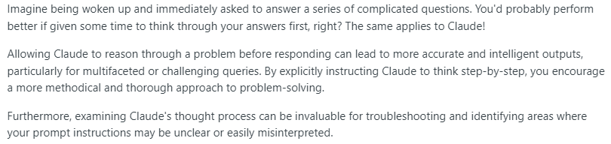
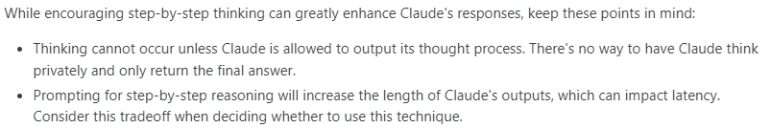
Let Claude Think
Notes:
https://docs.anthropic.com/claude/docs/let-claude-think

Slide 2
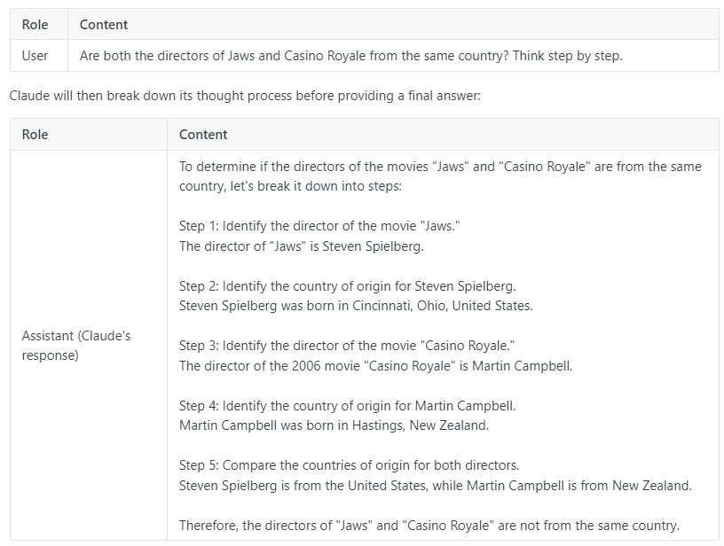
Thinking: Simple Example

Slide 3
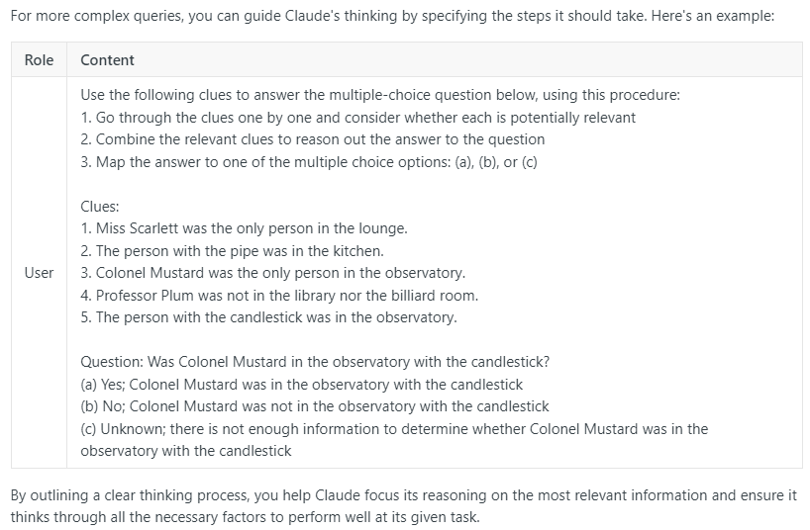
Thinking: Complex Example

Slide 4
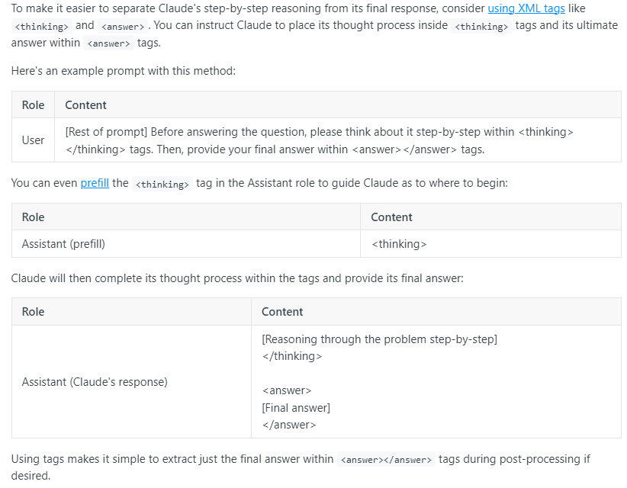
Thinking: capturing the thought process

